Slide 1

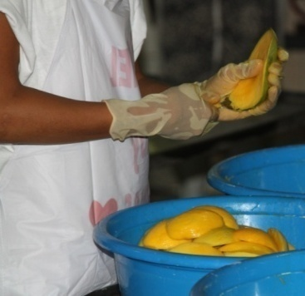
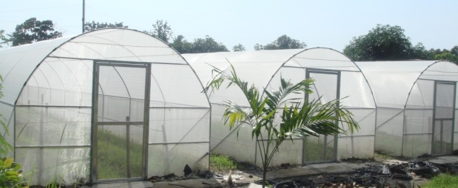
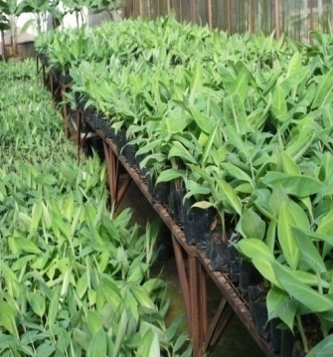
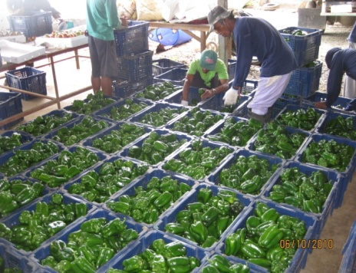
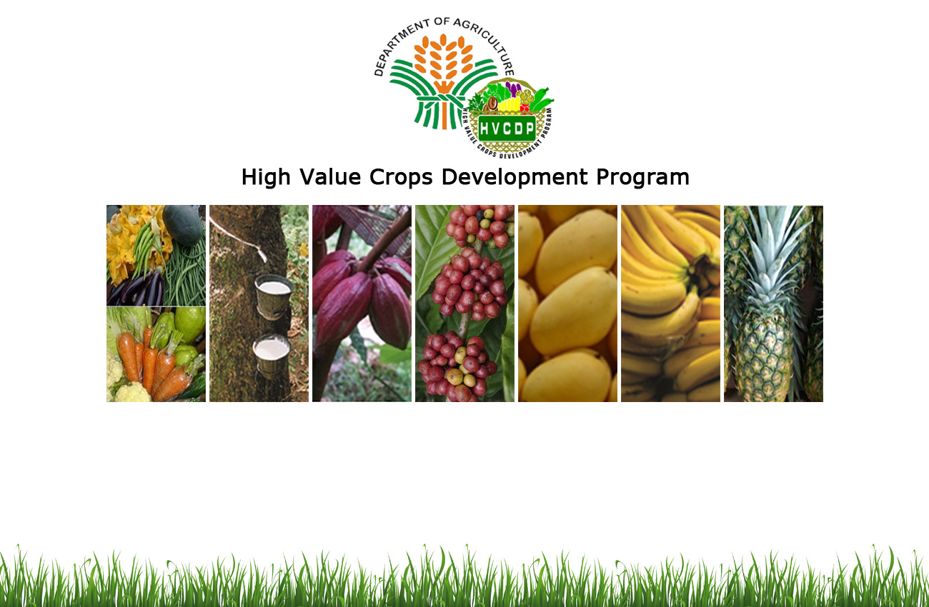
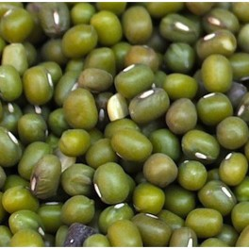
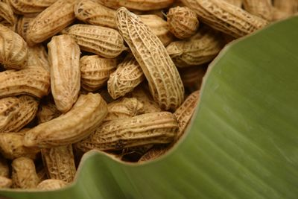
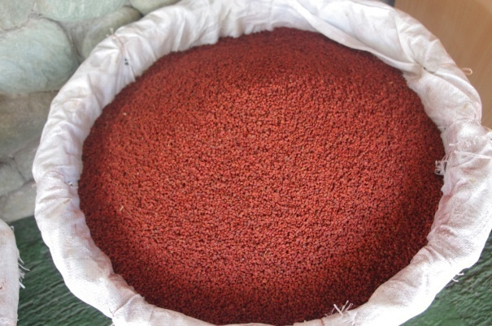
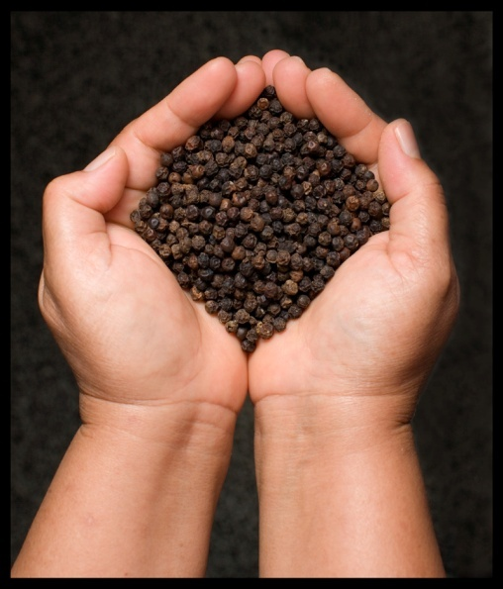
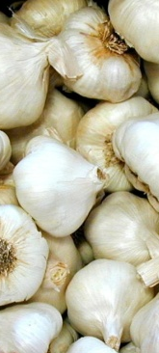
program directions

Slide 2
MANDATE
Created through RA 7900 and aims to address poverty and sustain growth in agricultural economy of the country
  Help increase income, create livelihood opportunities and contribute to the Philippines’ agricultural development
  Support the promotion of the production, processing and marketing and distribution of high value crops

Slide 3
VISION
To have a productive community
MISSION
Empower the farmers especially the high value crops producer
Attain food sufficiency and economic growth
GOALS
Increase production, income and livelihood opportunities among small producers
Have access to affordable, safe and healthy food

Slide 4
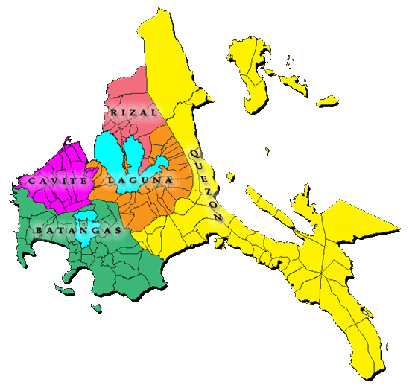





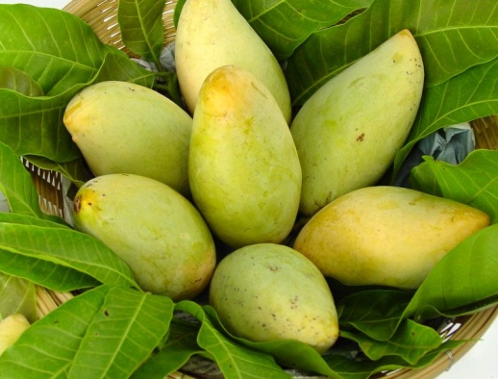
REGIONAL PRIORITY COMMODITIES
B
5 provinces, 26 cong’l districts, 16 cities, 126 municipalities and 4,011 brgys.
Total Land Area : 1,664,403 has.
Agricultural Land Area : 794,793.69 has.
Total Population : 14,414,774 M
Annual Growth Rate of
Population- 2010-2015: 2.58%
Poverty Incidence : 10.4%
Constribution to GDP: 17.36%
Contribution of Agriculture, Hunting, Forestry and Fishing sector to the regional economy: 6.14 %
Notes:
CALABARZON is composed of 5 Provinces of Cavite, Laguna, Batangas, Rizal and Quezon with 26 congressional districts, 16 cities, 126 municipalities and 4,011 barangays.
CALABARZON is an industrialized region with a total land area of 1.66 M has, 48% or 794,793.69 has of which is agricultural. It has a population of 14.4M that is growing at an annual growth rate of 2.58% with a poverty incidence of 10.4%. Its proximity to Metro Manila provided CALABARZON with a ready market for its agricultural produce.
The agricultural commodities when ranked according to value of its production (volume x price), revealed that livestock and poultry ranked 1st with a value of Php 86.74 B. This is followed by sugarcane, pineapple, palay, vegetable, pineapple, mango, banana, rootcrops, corn and coffee,
At the national scene, CALABARZON is 2nd top producer of hogs, chicken, and cattle and 3rd top producer of cattle in the Philippines. CALABARZON is also a major supplier of lowland vegetables especially squash, eggplant and ampalaya.
CALABARZON contributed 17.36 percent to the country's Gross Domestic Product. Agriculture, Hunting, Forestry and Fishing sector accounted for 6.14 percent of the regional economy (PSA, 2013 data).
Note:
The identification of top commodities of the region was done by considering the volume of production and the value of the produce. Livestock and poultry is considered as one commodity as well as the consolidation of lowland vegetables. The value of production is in Php ‘000, which was computed by multiplying the volume of production and the price at farmgate of agri crops and eggs. For livestock and poultry, the wholesale price of the commodity was used.
Consistently, livestock and poultry is included as top priority in all provinces especially true for Batangas which is the egg capital of the Philippines.

Slide 5
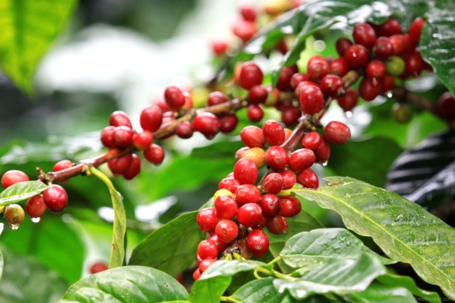



Coffee Plans and Programs

Slide 6
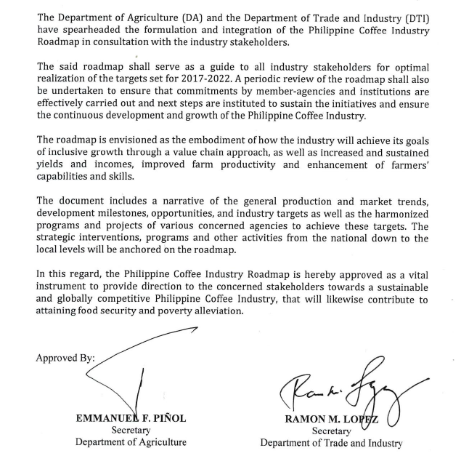
COFFEE ROADMAP
Started 6 years ago
Signed by DA Secretary Emmanuel Pinol and DTI-Secretary Ramon Lopez on March 7, 2017 in Malacanang.
Current status: EO to be jointly submitted by DA & DTI to President RRD soon, IRR draft being completed, signing scheduled within 1Qtr.

Slide 7
Coffee Industry Situationer
Volume of production of coffee declined by 4.86%; from 72,341 MT in 2015 to 68,823 MT in 2016. Reasons for the decline in coffee production are as follows:
  effect of heavy rains during the flowering stage of the crop
  cutting down of old and unproductive trees in the provinces of Zamboanga Del Norte and Compostella Valley.
The top (5) producing coffee regions are as follows:
  SOCCSKARGEN (25,101 MT)
  Davao Region (11,430 MT)
  ARMM (10,343 MT)
  Northern Mindanao (5,605 MT)
  Western Visayas (4,356 MT)
SOURCE: PSA-BAS

Slide 8


COFFEE:
  CALABARZON Region is one of the leading coffee producers of the country. Cavite and Batangas more often, remain in the top five (5) producing provinces from 2010-2015. In 2016, CALABARZON contributed 11% of the coffee production of the whole country. The region had the highest production of 8,568 metric tons in 2012 and the lowest production of 2,272 mt. in 2015. The decrease were attributed to typhoon Glenda, marketing problems and reluctance of coffee growers to rejuvenate the old trees and shifting to other crops.
  Cavite has the highest area planted of 8,250 hectares while Rizal has lowest
  area of 60 hectares. Robusta variety dominates the coffee area with 10,851 hectares
  planted followed by Excelsa, Liberica and Arabica with 2,326, 197,and 35 hectares planted
  respectively.

Slide 9
OPPORTUNITIES
Availability of improved production and processing technologies
Coffee can be intercropped with vegetables and other fruit trees
(maximum land utilization)
Can be utilized for watershed rehabilitation project
Growing market for specialty coffee
Availability of potential land areas for expansion
Increasing number of coffee processors demanding quality raw material
Increasing presence of geographic brands
Possibility of import substitution since imports account for over 80 percent of supply

Slide 10
CONSTRAINTS
Low yield due to lack of maintenance and old trees
Limited good quality planting materials
Erratic agro-climate condition/climate change
Competition with other crops
Small farmers lack access to quality and affordable planting materials
Inadequate physical and organizational infrastructure
Cheaper and better quality imports
Fluctuating coffee prices in international market
Strong competition from imported beans
Land conversion

Slide 11
Philippine Development Plan (PDP) Result Matrices
Yield of coffee increased (in metric tons per hectare)
 | 2017 | 2018 | 2019 | 2020 | 2021 | 2022
Yield (in metric tons per hectares) dried berries | 0.6 | 0.7 | 0.8 | 1.0 | 1.4 | 2.0
Yield (in metric tons per hectares) green coffee beans | 0.3 | 0.35 | 0.4 | 0.5 | 0.7 | 1.0
Program area for coffee increased (in hectares)
 | 2017 | 2018 | 2019 | 2020 | 2021 | 2022
Area Expansion (in hectares) | 13,705 | 4,120 | 6,592 | 9,888 | 10,877 | 11,964
Planting materials (piece) | 13,705,000 | 4,120,000 | 6,592,000 | 9,888,000 | 10,877,000 | 11,964,000

Slide 12

Situationer CALABARZON, 2016
Production (MT) | 2,817.5
Consumption (MT) | 3,390.5
Deficit (MT) | 573
Sufficiency | 83%

Slide 13

Area Planted (ha),Bearing Trees
Year | 2012 | 2013 | 2014 | 2015 | 2016
Philippines | 120,000 | 116,460 | 117,451 | 113,738 | 114,838.9
Calabarzon | 13,563 | 13,564 | 13,466 | 13,409 | 13,472
% SHARE | 11.3 | 11.7 | 11.5 | 11.8 | 11.7
Source : BAS

Slide 14

Production (MT)
Year | 2012 | 2013 | 2014 | 2015 | 2016
Philippines | 88,943 | 78,634 | 75,454 | 72,342 | 68,822.93
Calabarzon | 8,568.05 | 5,237.66 | 4,691.24 | 2,272.20 | 2,817.5
% Share | 9.6 | 6.7 | 6.2 | 3.1 | 4.1
Source : BAS

Slide 15
Strategic Plan - Coffee
Improve quality and availability of planting materials
Enhance farm efficiency and investments
Promote accreditation of nurseries and plant material certification
Training/retooling of plant nursery evaluators (PNE) and plant materials inspectors (PMI)
IEC campaign on GAP/best farm practices including seed selection, rejuvenation, etc.
Invest in mother clonal gardens and nurseries
Conduct trainings for nursery establishment
Reproduce and distribute IEC materials to farmers
Develop public private partnership for planting and replanting projects;
Develop public private partnership for expansion of seed/clonal gardens
Conduct trainings with TESDA/ATI /coffee experts
Benchmarking and best practices dissemination
Conduct trainings on GAP/GMP

Slide 16
Strategic Plan - Coffee
Improve competitiveness
Enhance processing efficiency (provision of processing technology)
Establish guidelines and promote quality standards for Philippine Coffee.
Strengthen and build competencies of farmers/ processors for the adoption, dissemination of standards;
Incentivize compliance to product standard
Improve packaging and labels of coffee products including quality seal
Establish village/ SME level facilities
Conduct workshops on industry clustering and value chain analysis and entrepreneurial trainings
Provide coffee post-harvest trainings
Provision of appropriate facilities (local or imported) with affordable terms
Promote investment opportunities in specialty coffee markets

Slide 17
Strategic Plan - Coffee
Review financing program for coffee
Improve market price and coffee standards
Access to long term funds
Daily world price and other market information access from DA website / SMS
Convene concerned organizations to settle standards
Find alternative markets
Tap agricultural/ trade attaches in Philippine embassies
Establish/ develop and aggressively promote Philippine Coffee (quality, brand, logo)
Develop market niching with the specialty coffee market and other alternative markets
Develop appropriate financing packages for coffee farmers/ SMEs
DA to endorse proposal to LBP/ SB Corporation

Slide 18
Improve Research and Extension Services
Reliable Industry Data
Coffee industry census
Industry Unity in Diversity
Conduct seminar on organizational development
R and D program on variety by region
Establishment of coffee grading and cupping laboratory
Establishment/ regular updating of buyer-supplier and coffee network database
Team building
Conduct Regular TWG/Council Meetings

Slide 19
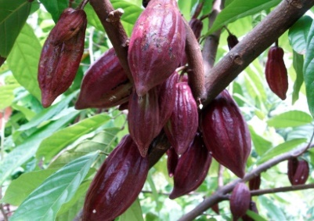
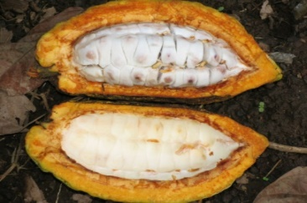

CACAO PLANS AND PROGRAMS

Slide 20
CACAO SITUATIONER
CALABARZON has a total cacao area of 1,371 hectares where 438 hectares is already producing 17.1 MT. Cacao production in 2010 was 22 thousand MT to 13 thousand MT in 2015 or a decreased of 9 thousand MT. The decline in output was attributed to the frequent rainfall that adversely affected the production areas in CALABARZON. However area planted increased from 330 hectares in 2010 to 336 hectares in 2015 and 438 ha. in 2016 due to area expansion in Quezon Province.
Cacao beans when processed become cocoa powder, cocoa cake, and cocoa butter which are used mainly for the manufacture of chocolates, soaps, cosmetics, shampoo and other pharmaceutical products.

Slide 21


OBJECTIVES
To increase production of cacao by 40% per year;
Increase the yield of cacao from 0.1 mt/ha to 0.8mt/ha by 2022
and increase cacao production from 760 mt to 2,500 mt by 2022
To increase value-adding and;
To increase farmer’s income to least 130k/ha/year
To contribute to the goal of attaining inclusive growth and poverty alleviation through:
  Increase in farmers income to at least PhP130,000 per hectare per year;
  Increase export sales by at least USD 250-M per year; and,
  Generate at least 150,000 jobs by 2022

Slide 22

NATIONAL PRODUCTION
 | 2015 | 2016
Volume of Production (mt) | 6,024 | 6,263
Area Planted/Harvested (ha) | 13,911 | 14,816
Yield (mt/ha) | 0.43 | 0.42
TOP 5 CACAO PRODUCING REGIONS
REGIONS | VOLUME OF PRODUCTION (MT)
Davao Region | 5,074
Northern Mindanao | 180
Zamboanga Peninsula | 127
Cagayan Valley | 125
SOCCSKSARGEN | 93
Source : PSA-BAS

Slide 23
Philippine Development Plan (PDP) Results Matrices
Program area for cacao increased (in hectares)
 | 2017 | 2018 | 2019 | 2020 | 2021 | 2022
Area Expansion (in hectares) | 24,715 | 4,220 | 6,330 | 8,229 | 9,875 | 11,850

Slide 24
Situationer CALABARZON, 2016
Production (MT) | 74,011
Consumption (MT) | 717,120
Deficit (MT) | 643,109
Sufficiency | 10.3%

Slide 25
Area Planted (ha),Bearing Trees
Year | 2012 | 2013 | 2014 | 2015 | 2016
Philippines | 187,428.1 | 183,483.8 | 182,415.9 | 182,000 | 182,414.3
Calabarzon | 17,602.0 | 17,582.3 | 17,393.3 | 16,575.0 | 16,472
% SHARE | 9.4 | 9.6 | 9.5 | 9.1 | 9.0
Source : BAS

Slide 26
Production (MT)
Year | 2013 | 2014 | 2015 | 2016
Philippines | 2,557,109 | 2,567,495 | 2,627,129 | 2,474,199
Calabarzon | 77,558.71 | 68,599.75 | 62,624.06 | 74,011
% Share | 3.0 | 2.7 | 2.4 | 3.0
Source : BAS

Slide 27
OPPORTUNITIES
The domestic market is vastly undersupplied
Impending global supply shortfall, demand on upward trend
Underutilized capacity, presence of support facilities
Increase demand for cacao processed products, i.e. chocolate
Higher profit margin for value added products
Presence of consolidators/exporters
Entry of new players, encourage competition & pushes prices
Premium price for fermented and certified cacao
Large coconut and banana areas available for inter cropping
Availability of government support programs
Extensive R&D on varietal improvement
Good germplasm
Government Seedlings Dispersal Program
Availability of input suppliers

Slide 28
CONSTRAINTS
High transport cost
Stringent quality standards requirements
Beans production still limited
Limited value adding activities and inadequate
Low level of consciousness on product quality & standards
Price fluctuation, cacao being a globally traded commodity
Inadequate fermentation facilities and skills on fermentation
Low farm productivity level, low level of skills on GAP
Inadequate post harvest facilities basic infrastructures
Inadequate supply of good quality seedling materials
Limited access to high yielding scion/clone materials
Proliferation of non-accredited nurseries
High cost of farm inputs

Slide 29
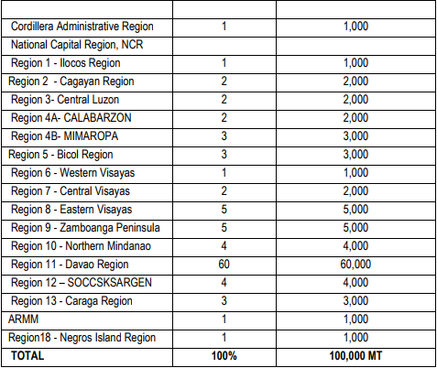
Targets
Regional Commitments
At least 50M cacao trees producing 2.0 kilogram (kg) dried beans equivalent per tree
At least 100,000MT production volume of quality cacao beans;
At least 100,000 farmers getting additional income of Php130,000.00 per hectare/year; and,
Additional export earnings of at least USD 250-M
With these targets, seventeen (17) regions in the country signified their commitment to participate in the attainment of the industry goal and objectives by taking a percentage share from the national target.

Slide 30


Strategic Plan - Cacao
Quality standards & certification advocacy
Conduct of Regional Convergence and Creation of Regional Cacao Industry Councils
Industry Strengthening,Expansion and Production
Strengthen market linkage and promotion
Facilitate RDC recognition of Regional Cacao Industry Council & endorsement of cacao as priority sector
Promote harmonization/convergence of agency budgets and production targets
Conduct of Asia Pacific Cacao Conference
Conduct investment and techno forum
Establish of industry databank
Creation of a Philippine Cacao Board or Council thru Presidential E.O.
Conduct farmer’s field day and industry forum
Organize the Philippine Cacao Festival
Participation to international, national and regional exhibits/fairs
Market linkages and referrals (local and foreign)
Packaging and labelling consultancy
Orientation on single origin, traceability and GIS
Credit & marketing assistance program for ARBOs
Promotion of a collective trademark for Philippine Cacao Export Products
Standards Development for Philippine Cacao Products

Slide 31
Strategic Plan - Cacao
GAP on Cacao
Establishment of nurseries and budwood gardens (including training)
Increase Production and Access to Quality Planting Materials
Improve Farm Productivity
Integrated Pest Management
Streamline plant nursery accreditation and certification
Planting material distribution(PCA, DA, DENR)
Provision of supplies and materials to expand the established nurseries
Provision of farm infrastructures (FMR, Irrigation system)
Provision of Postharvest facilities, fermentation, dryers, etc
Training on cacao fermentation and drying
Support to FITS Centers, School on the Air, Farmers’ Field Schools, etc
Creation of Inter-Agency Convergence Initiatives to support the various Capacity Building Activities
Science and Technology Community Based Farming (STCBF)
Inventory of existing & potential cacao production areas particularly on ARC’s

Slide 32
Strategic Plan - Cacao
Varietal Improvement Program
Promotion of Value-Added Products
Continual Research and Development
Conduct of Skills and Techno Transfer Training on Cacao Processing
Conduct of entrepreneurship seminars
Conduct of Product Development Clinics and technology upgrading
Productivity Enhancement Trainings
Provision of Cacao Processing Facilities (Common Service Facilities)
Creation of Inter-Agency Convergence Initiatives to support Capacity Building Activities for cacao processing
Utilization of cacao pod husk as fuel briquettes, cellulose acetate, feeds and pectin
Utilization of cacao dripping as wine, vinegar, ethanol and pectin
Building cacao waste village enterprise models in strategic growing areas.
Cultural Management Program
Pest and Diseases Control Program
Improvement of Post harvest Technologies and establishment of R&D Center which include laboratory facilities
Cacao Industry Profiling, Mapping and Geo-Tagging
Explore R&D Collaborations with Cacao Industry Experts in the BIMP-EAGA

Slide 33

Strategic Plan - Cacao
Resource Generation and Mobilization
Credit facilitation
Design Special Programs
LBP Cacao 100
SBC Financing Program
Capacity Building for resource generation
APCP & LBP: Financing Facilitation
Institutionalize a Convergence Mechanism for the preparation of Agency Budgets and Performance Targets Re: Cacao Industry Development
Agri-Insurance Program under ARAs

Slide 34
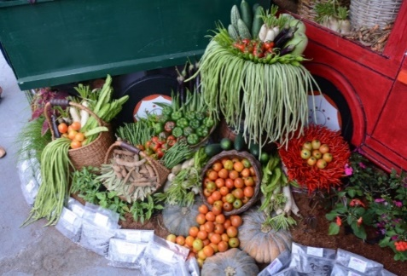
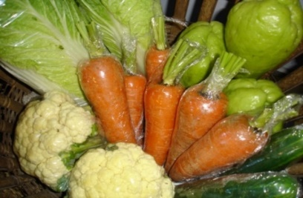

VEGETABLES PLANS AND PROGRAMS

Slide 35
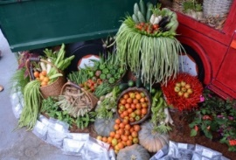

VEGETABLES SITUATIONER
Based on the data generated by the Bureau of Agricultural Statistics (BAS), in terms of the top priority vegetables, volume of production decreased by 4.82% from CY 2015-2016 (from 1,652,451 MT to 1,572,673 MT).
Area planted/harvested decreased by 1.58% from 186,055 hectares (CY 2015) to 183,124 hectares (CY 2016).
Source : PSA-BAS

Slide 37
OPPORTUNITIES
Increasing demand (domestic and foreign)
Available transport network
Health benefits
Prioritization on the production of vegetables
Demand for organic vegetables

Slide 38
CONSTRAINTS
High input cost and excessive use of inorganic fertilizers and pesticides
Effect of climate change
High labor costs for land preparation, planting and harvesting
Low vegetable consumption
High postharvest losses
Land conversion (agri to industrial)
Smuggling (inputs and vegetables)

Slide 39
STRATEGIES AND SUPPORT PROGRAMS

Slide 40
Stabilize the Supply of Vegetables
Area expansion- through seed distribution, with focus on off season in crops with high farm gate prices
Increase yield in low yielding regions through support for irrigation, techno demo areas and training, use of better quality seeds

Slide 41
Improve the Quality and Convenience of Locally Produced Vegetables in the Market
Establishment of postharvest processing system
Improvement of market information system
Ensure the safety of vegetables in the market

Slide 42
Enhance the Acceptability of Vegetables for Healthier Eating Habits (in support to food sufficiency program)
Sustained education and public awareness campaign using tri-media; advocacy; IEC materials to target groups
Promotion of urban and school gardening
Promotion of home/backyard gardens
Ensuring availability of seeds and planting materials

Slide 43
Provision of Quality Support Services to Vegetable Growers to Enhance their Competitiveness and Sustainability
Support to the provision of seeds and planting materials, production facilities, small-scale irrigation facilities, marketing activities, postharvest machineries/ equipment and infrastructure/facilities,
Conduct of trainings
Organization and strengthening of cooperatives

Slide 44
Strategy 5. Expand Overseas Market for Philippine Produced Vegetables
Improve market information system and increase market linkage to other countries
Promotion of other vegetable products (with high shelf life)

Slide 45

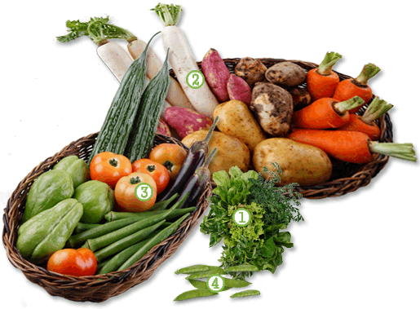
Situationer CALABARZON, 2015
Production (MT) | 139,097.84
Consumption (MT) | 226,639.00
Deficit (MT) | 87,541.16
 | 61.4%
SUFFICIENCY

Slide 46
Production (MT)
Year | 2013 | 2014 | 2015 | 2016
Philippines | 844,480 | 890,646 | 900,289 | 895,682
Calabarzon | 125,725 | 125,598 | 128,467 | 122,392
% Share | 15 | 14 | 14.3 | 13.7
Source : psa

Slide 47
AREA PLANTED (ha)
Year | 2013 | 2014 | 2015 | 2016
Philippines | 79,431 | 78,771 | 78,136 | 78,104
Calabarzon | 9,121 | 8,899 | 8,578 | 8,527
% Share | 11.5 | 11.3 | 11 | 10.9
Source : BAS

Slide 48
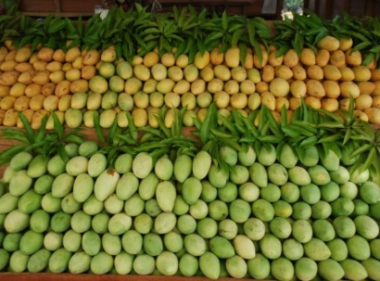
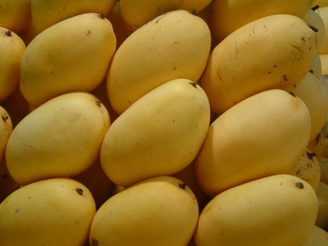
MANGO PLANS AND PROGRAMS

Slide 49
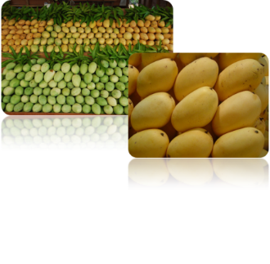
MANGO SITUATIONER
Mango is the 3rd most important fruit crop of the country based on export volume and value next to banana and pineapple.
The country’s export variety, the ‘Carabao’ is one of the best varieties in the world.
About 73% of the total area planted is owned by small farmers and 24% operates farm sizes 3 to 9.99 hectares.

Slide 50
NATIONAL PRODUCTION
 | 2015 | 2016
Volume of Production (mt) | 902,739 | 814,055
Area Planted/Harvested (ha) | 188,422 | 187,834
Yield (mt/ha) | 4.79 | 4.33
TOP 5 MANGO PRODUCING REGIONS
REGIONS | VOLUME OF PRODUCTION (MT)
Ilocos Region | 209,375
Zamboanga Peninsula | 114,910
Central Visayas | 66,539
Central Luzon | 61,998
Cagayan Valley | 60,855
Source : PSA-BAS

Slide 51
OPPORTUNITIES
Large domestic market/demand.
High demand in the international market for fresh, dried and puree
Strategic geographical location in ASEAN and whole Asian markets
Expanding export markets

Slide 52
CONSTRAINTS
Strong competition from imported fruits
Stiff competition from other mango producing countries (Mexico, Thailand, Vietnam)
Predominance of Florida types in the world market
Climate change
Emergence of new pests and diseases
Massive cutting of mango trees
Declining number of mango growers/spray contractors/financiers
High postharvest losses, few processed products
Low export of both fresh ( high pesticide residues and low quality) and processed mango

Slide 53
Philippine Development Plan (PDP) Results Matrices
Yield of mango increased (in metric tons per hectares)
 | 2017 | 2018 | 2019 | 2020 | 2021 | 2022
Yield (mt/ha) | 4.98 | 5.08 | 5.18 | 5.28 | 5.39 | 5.50
Program area for mango increased (in hectares)
 | 2017 | 2018 | 2019 | 2020 | 2021 | 2022
Area Expansion (in hectares) | 508 | 4,416 | 4,420 | 4,425 | 4,429 | 4,434

Slide 54
STRATEGIES AND SUPPORT PROGRAMS
Increase productivity and production
Establishment, rehabilitation and maintenance of production facilities focusing on new varieties (nursery, foundation scion grove, etc.)
Provision of production inputs and farm machineries /equipment (quality planting materials, power sprayers, flower inducers, bio control agents, etc.)
Establishment of Learning Sites
Pests and diseases monitoring and surveillance
Information dissemination ( IPM, Quality enhancement, GAP, traceability, etc) through IEC and school on the air (SOA)
Research and development on variety development, bio control agents and other organic inputs, product development

Slide 55
STRATEGIES AND SUPPORT PROGRAMS
Increase in mango consumption
Strengthening market linkage in export
Promotion of mango as a healthy produce in coordination with other agencies (DOH, NNC, etc)
Promotion of other varieties of mango as green and processed product
  Product promotion thru conduct of trade fairs, exhibits, trade missions
  Benchmarking and market reconnaissance
  Provision of Postharvest/Processing Equipment and Machineries
  Community-Based Processing/Postharvest Facilities
  Support for GAP certification of mango farms

Slide 56
Situationer CALABARZON, 2016
Production (MT) | 50,465
Consumption (MT) | 119,232
Deficit (MT) | 68,767
Sufficiency | 42.3%

Slide 57
Area Planted (ha),Bearing Trees
Year | 2012 | 2013 | 2014 | 2015 | 2016
Philippines | 188,719 | 187,939 | 188,092 | 188,422 | 187,834
Calabarzon | 14,557 | 14,185 | 14,185 | 13,972 | 13,950
% SHARE | 7.7 | 7.5 | 7.5 | 7.4 | 7.4
Source : BAS

Slide 58
Production (MT)
Year | 2012 | 2013 | 2014 | 2015 | 2016
Philippines | 768,410 | 816,378 | 885,038 | 902,739 | 814,055
Calabarzon | 55,215 | 54,291 | 59,474 | 59,041 | 50,465
% Share | 7.2 | 6.7 | 6.7 | 6.5 | 6.2
Source : BAS

Slide 59
BANANA PLANS AND PROGRAMS

Slide 60
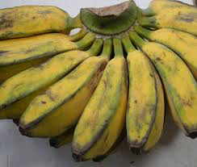

BANANA
In 2004-2015, the average banana production in CALABARZON reaches up to roughly
119,208 MT making it the 7th most produced commodity in the region.
LIST OF TOP BANANA PRODUCING MUNICIPALITIES
CAVITE - Amadeo, Gen. Aguinaldo, Indang, Silang, Maragondon, Alfonso, Mendez, Trece Martires City, Magallanes, and Dasmarinas
LAGUNA – Nagcarlan, Calauan, Alaminos, San Pablo City, Mabitac, Calamba, Sta. Maria, Pangil, Pakil, and Siniloan
BATANGAS – Lipa City, Tanauan City, Mataas na Kahoy, San Juan, Nasugbu, Balite, Batangas City, Cuanca, Mabini, and Sta. Teresita
RIZAL – San Mateo, Jala Jala, Rodriguez, Antipolo City, Cardona, Baras, and Binangonan
QUEZON – San Francisco, Dolores, Infanta, Buenavista, Mauban, Lucena City, Unisan, Lopez, Sampaloc, and Tagkawayan

Slide 61
BANANA
OBJECTIVES
Increase production by 10% per year
Increase production yield by 10% per year
Expand production area by 10% per year
Minimize production cost by adopting organic farming

Slide 62
Situationer CALABARZON, 2016
Production (MT) | 74,011
Consumption (MT) | 717,120
Deficit (MT) | 643,109
Sufficiency | 10.3%

Slide 63
Area Planted (ha),Bearing Trees
Year | 2012 | 2013 | 2014 | 2015 | 2016
Philippines | 187,428.1 | 183,483.8 | 182,415.9 | 182,000 | 182,414.3
Calabarzon | 17,602.0 | 17,582.3 | 17,393.3 | 16,575.0 | 16,472
% SHARE | 9.4 | 9.6 | 9.5 | 9.1 | 9.0
Source : BAS

Slide 64
Production (MT)
Year | 2013 | 2014 | 2015 | 2016
Philippines | 2,557,109 | 2,567,495 | 2,627,129 | 2,474,199
Calabarzon | 77,558.71 | 68,599.75 | 62,624.06 | 74,011
% Share | 3.0 | 2.7 | 2.4 | 3.0
Source : BAS

Slide 65
Function | Constraints | Intervention | Activities
Input supply
 | Inadequate supply of disease-free planting materials | Support to existing tissue-cultured laboratories Establishment of municipal or cluster nurseries | Rehabilitation of existing tissue laboratories Establishment of on site nurseries Strenghten pest monitoring
 | Limited knowledge on fertilizer and herbicide management | Capability building of banana farmers | Conduct of trainings on Package of Technologies(POT)
 | Limited knowledge on GAP | Training on GAP | Dessimination of IEC materials on GAP

Slide 66
Function | Constraints | Intervention | Activities
Production
 | Limited supply of fresh saba | Provision of planting material | Distribution of disease free planting material
 | No organized banana growers | Consultation with the LGUs and organizational & entrepreneural development | Organize farmer groups per province

Slide 67
Function | Constraints | Intervention | Activities
Postharvest
 | 'Lack of post harvest machineries facilities | Provision of storage facilities to be situated in a community or cluster base structure | Construction of warehouse / packing house Training on the operation of the facility Regular monitoring and evaluation
PROCESSING
 | Limited technical know-how on standards and equipments for saba processing | Provide trainings/seminars on GMP, HACCP, and PNS for Saba Provide processing equipments | Conduct training GMP, HACCP, and PNS Distribution of processing equipments

Slide 68
Improve quality and availability of planting materials
Strategic Interventions
Improve cost competitiveness
Provision of other support system (small-scale irrigation projects)
Provision of production equipment and machineries and establishment of facilities
Improve research, development and extension services

Slide 69
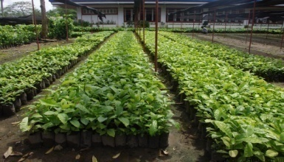
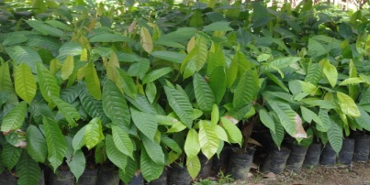
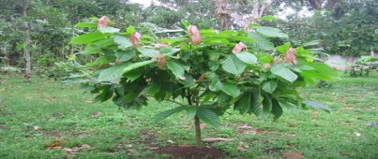
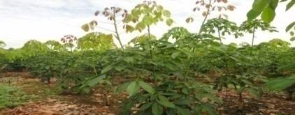
AREA EXPANSION
Commodities : Coffee, Cacao, Rubber
Objective : Increase productivity and production
Major Interventions :
Planting materials
Production facilities
(e.g. nursery, clonal garden, budwood garden)
Extension Support
Coffee
Cacao
Cacao
Rubber

Slide 70
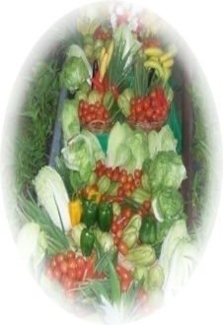
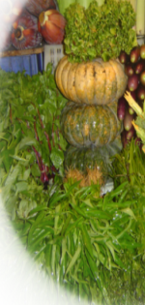
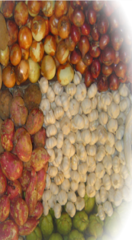
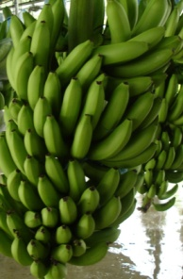
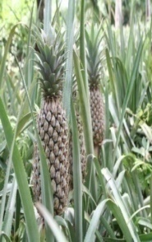
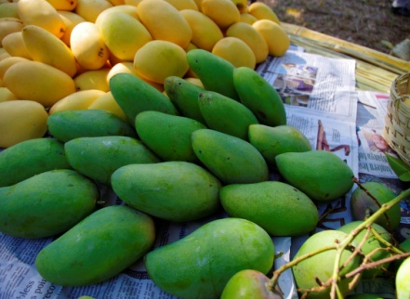
PRODUCTIVITY ENHANCEMENT
Commodities : Vegetables, Fruits, Rootcrops
Objective : Enhance productivity and
production
Targets :
Vegetables : Increase total production by 3% per year
Mango : Increase production of fresh and high quality mangoes by 5% annually
Banana
(Cavendish) : Increase export of fresh banana by 20%
(Lakatan) : Increase volume of production by 4%

Slide 71
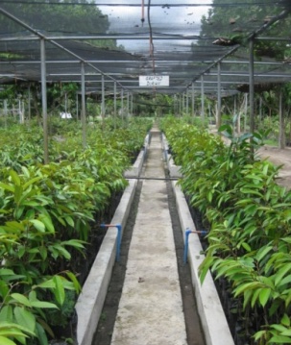
Production Targets (in mt):
Commodities | 2016
Vegetables* | 173,682mt
Banana | 112,647mt
Mango | 65,420 mt
* Top 20 priority vegetables
Major Interventions :
Seeds/Planting materials
Small-scale irrigation
Production equipment/machineries (e.g. tractor, sprayer)
Production facilities (e.g. nursery, greenhouse)
Extension Support

Slide 72
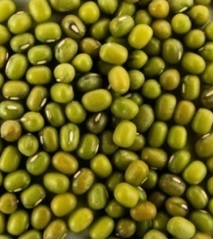
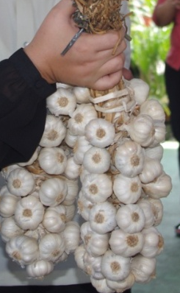
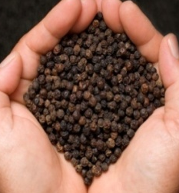
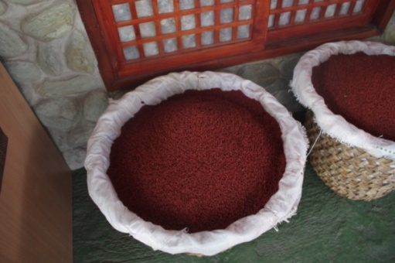
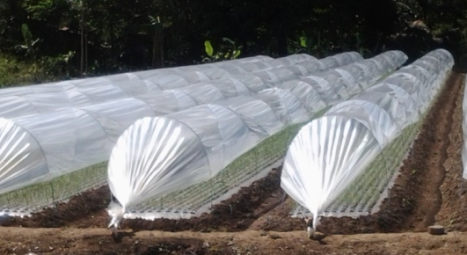
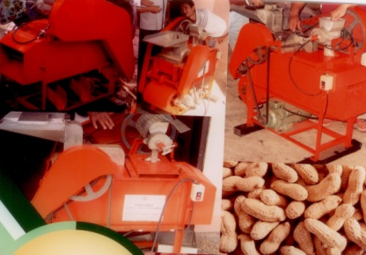
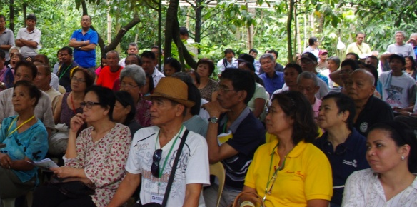
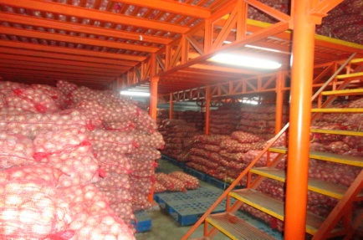
COST COMPETITIVENESS TOWARDS
Import substitution
Commodities : Mungbean, Peanut, Garlic, Achuete, Black Pepper
Objective : Lessen importation of various vegetables thru
increase in production
Major Interventions :
Seeds / Planting materials
Production and Postharvest equipment & facility
Extension Support
Research and Development
Market Development

Slide 73
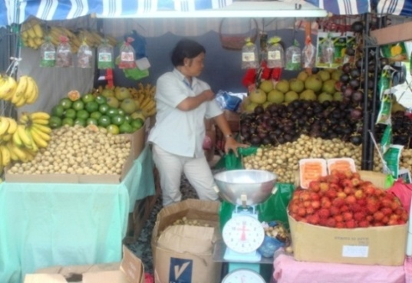
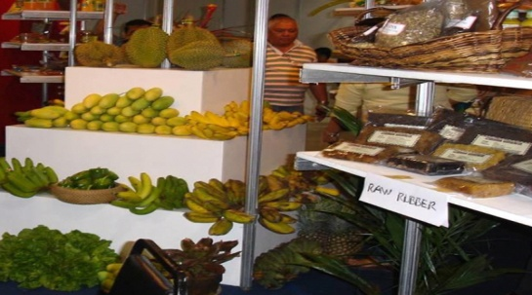
Support to production of local/traditional commodities with seasonal/local demand
Commodities : Local Fruits ( Lanzones, Mangosteen)
Objectives : Increase production of local traditional fruits
Promote regional/traditional fruits in the local
and international markets
Major Interventions :
Planting materials
Market-related activities
Small-scale irrigation
Extension Support
Production facilities
(e.g. nursery, foundation scion grove)

Slide 74
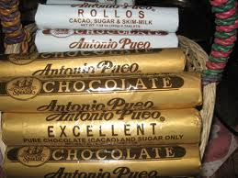

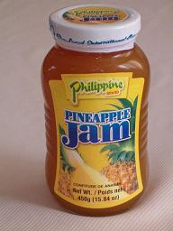

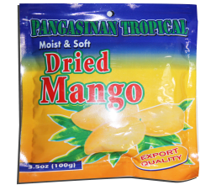
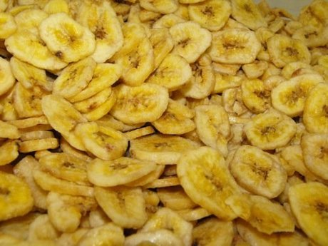




VALUE ADDING/PRODUCT DEVELOPMENT
Commodities : Fruits, Vegetables, Commercial Crops, Rootcrops
Objective : Provide additional income to farmers/organizations
Major Interventions :
Processing Equipment and Machineries
Community-Based Processing/
Postharvest Facilities
Research and Development
Depulper
Banana Chipper
Roaster
Cacao Solar Dryer
Coffee Roasting Center

Slide 75





SUPPORT TO CLIMATE CHANGE MITIGATION/ADAPTATION
Commodities : Vegetables, Coffee, Rubber, Fruits
Objective : Provide mitigating/adaptive measures for climate change
Major Interventions :
Seeds/planting materials production for buffer stocking
Production facilities (e.g. nursery, rainshelter)
Small-scale irrigation
Rainshelter
Windmill
Shallow Tube Well
Water plastic drum
HDPE Pipes

Slide 76

FY 2017 Physical Accomplishment Report as of November 30, 2017
MFO / PERFORMANCE INDICATOR | Annual Target | Accomp as of Nov. 30, 2017 | % Accomp | Remarks/ Target Date of Delivery/ Completion
Production Support Services
Beneficiaries provided with production support services
Seeds
Groups | 85 | 85 | 100
Individuals | 1.630 | 1,630 | 100
Seeds Distribution
Mungbean (kg) | 5,250 | 5,250 | 100
Peanut (kg) | 7,497 |  |  | Waiting for the submission of Accreditation/January 31, 2018
Ginger (kg) | 14,400 | 14,400 | 100
Garlic (kg) | 8,820 | 8,820 | 100
Lowland Vegetables (kg) | 450 | 450 | 100
Upland Vegetable (kg) | 175 | 175 | 100

Slide 77
FY 2017 Physical Accomplishment Report as of November 30, 2017
MFO / PERFORMANCE INDICATOR | Annual Target | Accomp as of Nov. 30, 2017 | % Accomp | Remarks/ Target Date of Delivery/ Completion
Planting materials
Groups | 297 | 292 | 98
Individuals | 1,550 | 2,662 | 171
Atchuete (pcs) | 20,000 | 20,000 | 100
Blackpepper (pcs) | 223,625 | 223,625 | 100
Lanzones (pcs) | 56,000 | 56,000 | 100
Rambutan (pcs) | 35,000 | 35,000 | 100
Mangosteen (pcs) | 10,000 | 10,000 | 100
Jackfruit (pcs) | 20,000 | 20,000 | 100
Coffee (pcs) | 334,200 | 75,000 | 22 | May 30, 2018
Cacao (pcs) | 791,400 | 571,000 | 72 | December 31, 2017
Yam (pcs) | 200,000 | 200,000 | 100

Slide 78
FY 2017 Physical Accomplishment Report as of November 30, 2017
MFO / PERFORMANCE INDICATOR | Annual Target | Accomp as of Nov. 30, 2017 | % Accomp | Remarks/ Target Date of Delivery/ Completion
School Garden /Gulayan sa Paaralan | 1,500 | 1,500 | 100
Production facilities maintained
Nursery ( units | )3 | 3 | 100
Seed storage (units) | 2 | 2 | 100
Production facilities established
Greenhouse (units) | 38 | 24 | 63 | 60 % Completed; December 31, 2017
Fertilizers and other soil ameliorants distributed
Flower inducer (liters) | 250 | 250 | 100
Programs and projects evaluated and monitored | 35 | 35 | 100
Meetings and consultations conducted | 30 | 35 | 116
Workshop conducted | 5 | 5 | 100
Support to Integrated Laboratory | 2 | 2 | 100

Slide 79
FY 2017 Physical Accomplishment Report as of November 30, 2017
MFO / PERFORMANCE INDICATOR | Annual Target | Accomp as of Nov. 30, 2017 | % Accomp | Remarks/ Target Date of Delivery/ Completion
2.2 Market Development Services
Market related events
Funded | 2 | 2 | 100
Participated/attended | 3 | 4 | 133
2.3 Extension Support, Education and Training Services
Participants trained
Farmers | 680 | 740 | 108
Female | 170 | 230 | 135
Male | 510 | 510 | 100
Package of Technology (POT) | 17 | 21 | 142

Slide 80
FY 2017 Physical Accomplishment Report as of November 30, 2017
MFO / PERFORMANCE INDICATOR | Annual Target | Accomp as of Nov. 30, 2017 | % Accomp | Remarks/ Target Date of Delivery/ Completion
IEC materials produced/reprinted | 3,000 | 3,000 | 100
Radio plugs aired | 3 | 4 | 133
Technology demonstration established | 96 | 96 | 100
Technology demonstration on rehabilitation of coffee,cacao and pili trees
Coffee
Number of site | 40 | 40 | 100
Number of trees fertilized | 725,694 | 725,694 | 100
Cacao
Number of site | 4 | 4 | 100
Number of trees fertilized | 112,000 | 112,000 | 100

Slide 81
FY 2017 Physical Accomplishment Report as of November 30, 2017
MFO / PERFORMANCE INDICATOR | Annual Target | Accomp as of Nov. 30, 2017 | % Accomp | Remarks/ Target Date of Delivery/ Completion
MFO 3. IRRIGATION NETWORK SERVICES
Beneficiaries of small scale irrigation projects
Groups | 29 | 32 | 110
Service area | 37 | 37 | 100
Spring development (units) | 4 | 4 | 100
Pump Set (STW/PISOS) (units) | 25 | 25 | 100
HDPE Pipe (meters) | 8,000 | 8,500 | 106

Slide 82
FY 2017 Physical Accomplishment Report as of November 30, 2017
MFO / PERFORMANCE INDICATOR | Annual Target | Accomp as of Nov. 30, 2017 | % Accomp | Remarks/ Target Date of Delivery/ Completion
MFO 5. AGRICULTURAL AND FISHERY MACHINERY, EQUIPMENT, AND FACILITIES SUPPORT SERVICES
Beneficiaries of production machinery, equipment and facilities
Groups | 173 | 193 | 111
Tractors (unit) | 5 | 5 | 100
Vegetable seeder (unit) | 10 | 10 | 100
Hand tractor/multi-cultivator (unit) | 40 | 48 | 100
Knapsack sprayer (units) | 500 | 500 | 100
Pole prunner/ shear (pcs) | 35 | 35 | 100

Slide 83
FY 2017 Physical Accomplishment Report as of November 30, 2017
MFO / PERFORMANCE INDICATOR | Annual Target | Accomp as of Nov. 30, 2017 | % Accomp | Remarks/ Target Date of Delivery/ Completion
MFO 5. AGRICULTURAL AND FISHERY MACHINERY, EQUIPMENT, AND FACILITIES SUPPORT SERVICES
Beneficiaries of production facilities
Groups | 20 | 16 | 80
Rainshelter (units) | 21 | 5 | 23 | 23 % completed: January 31, 2018
Screenhouse/nethouse (units) | 6 | 6 | 100
Nursery (units) | 5 | 5 | 100

Slide 84
FY 2017 Physical Accomplishment Report as of November 30, 2017
MFO / PERFORMANCE INDICATOR | Annual Target | Accomp as of Nov. 30, 2017 | % Accomp | Remarks/ Target Date of Delivery/ Completion
Beneficiaries of postharvest machinery and equipment and postharvest/processing facilities
Groups | 40 | 35 | 87
Coffee dehuller (pcs) | 10 | 10 | 100
Coffee depulper (pcs) | 10 | 10 | 100
Pulverizer (pcs) | 10 | 10 | 100
Coffee dryer/ Cacao dryer (pc) | 4 | 4 |  | January 31, 2018
Multi-commodity solar dryer (units) | 22 | 22 | 100

Slide 85
FY 2017 Physical Accomplishment Report as of November 30, 2017
MFO / PERFORMANCE INDICATOR | Annual Target | Accomp as of Nov. 30, 2017 | % Accomp | Remarks/ Target Date of Delivery/ Completion
Establishment of Postharvest Facility
Packinghouse/mobile packinghouse | 5 |  |  | 50% completed; February 28, 2018
Community Based Processing Facility
Banana chips processing facility | 1 |  |  | 90% completed: December 31, 2017
Cacao products processing facility | 2 | 1 | 50 | 50% completed:Janaury 31, 2018

Slide 86
FY 2017 Financial Report as of November 30, 2017 (P’000)
Program/Activities/Projects Major Final Outputs |  |  | Allocation | Obligation | % Obligation | Disbursement | % Disbursement
OPERATIONS
 | MFO 2. Technical Support Services |  | 208,786 | 193,499 | 92.68 | 110,416 | 57
 |  | 2.1 Production Support Services | 134,005 | 129,585 | 96.70 | 75,000 | 57
 |  | 2.2 Market Development Services | 900 | 416 | 46.22 | 416.00 | 100
 |  | 2.3 Extension Support, Education and Training Services | 73,881 | 63,498 | 85.95 | 35,000 | 55
 | MFO 3. Irrigation Network Services |  | 4,550 | 4,543 | 99.85 | 4,129 | 90
 | MFO 5. Agricultural and Fishery Machineries, Equipment and Facilities Services |  | 57,400 | 57,323 | 99.87 | 40,000 | 69
GRAND TOTAL |  |  | 270,736 | 255,365 | 94.32 | 154,545 | 60

Slide 87








FY 2017 (as of November 30, 2017) Highlights of Accomplishments for the Regional Priority Commodities
Distributed 25,000 bags Inorganic Fertilizer to support Coffee Rehabilitation Program
Coffee
Distributed 75,000 pcs Liberica Coffee
Provision of 35 units Pole Pruner

Slide 88





FY 2017 (as of November 30, 2017) Highlights of Accomplishments for the Regional Priority Commodities
Coffee
Conducted 5 Package of Technology Training on Coffee
Provision of 10 units Coffee Dehuller
Installation of Multi Commodity Solar Dryer

Slide 89






FY 2017 (as of November 30, 2017) Highlights of Accomplishments for the Regional Priority Commodities
Cacao
Distributed 561,750 Grafted Cacao Seedlings
Conducted Training on Code of Agricultural Practices on Cacao Production

Slide 90









FY 2017 (as of November 30, 2017) Highlights of Accomplishments for the Regional Priority Commodities
Vegetables
Distributed 450 kgs Lowland Vegetable Seeds
Provision of 5 units Four Wheel Drive Tractor
Provision of 48 units Multi tiller machine
Distributed 500 pcs Knapsack Sprayers

Slide 91







FY 2017 (as of November 30, 2017) Highlights of Accomplishments for the Regional Priority Commodities
Vegetables
Distributed 10 units Vegetable Seeder
Provision of 20 units Pump and Engine
Establishment of 5 units Spring Development
Distribution of 8,500 meters HDPE

Slide 92



FY 2017 (as of November 30, 2017) Highlights of Accomplishments for the Regional Priority Commodities
Establishment of 6 units Screenhouse
Conducted Meeting on Techno Demo Off-season Vegetable Production

Slide 93



1st Organizational Meeting of the new Regional Vegetable Growers Association
U

Slide 94



FY 2017 (as of November 30, 2017) Highlights of Accomplishments for the Regional Priority Commodities
Banana
1st Regional Banana Stakeholder’s Consultation

Slide 95



Crafting of 2018 Work and Financial Plan /Consultation with different Stakeholder

Slide 96



Updating of Agricultural Extension Workers on the
2017 programs and pojects

Slide 97








Established 1,500 sites Gulayan sa Paaralan
Distributed 1500 Assorted Garden Tools
Conducted Orientation cum Training on Gulayan sa Paaralan
Distributed 7500 bags Organic Fertilizer
Establishment of 24 units Greenhouse

Slide 98
Thank you and
God Bless us all!

